Slide 1
SPAN Image Analytics Update
Ryan Cabeen
July 30, 2020

Slide 2
Analytics Pipeline Overview
IDA
Image Collection
Download
Image Preprocessing: Conversion and Harmonization
Parameter Estimation:
Estimate maps of ADC & T2
Lesion Segmentation and Statistical Summary
Analytics Report and Visualizations

Slide 3
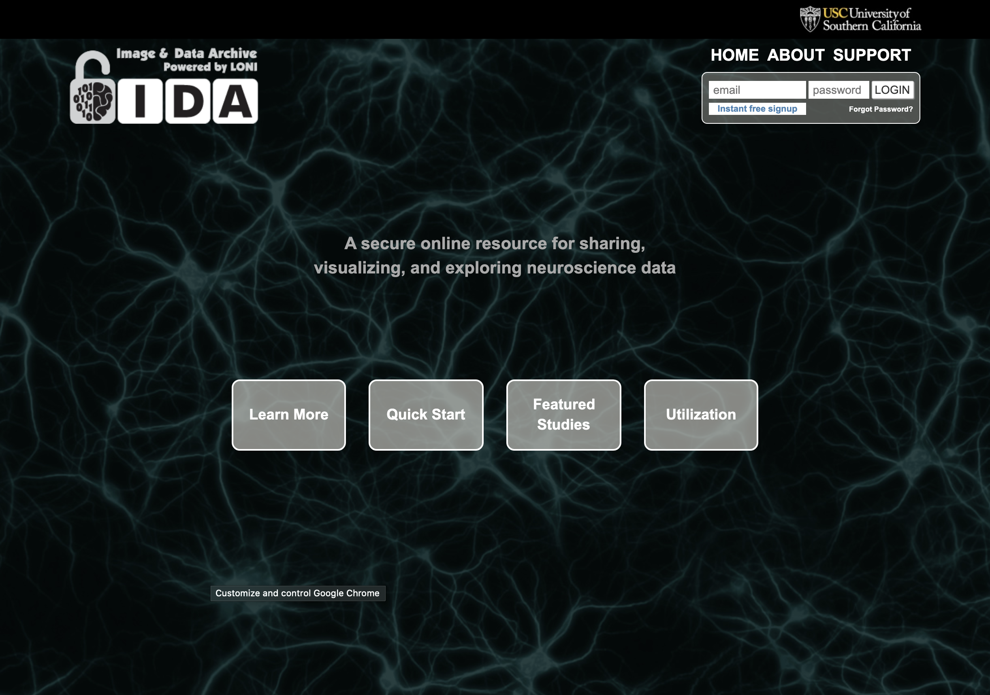
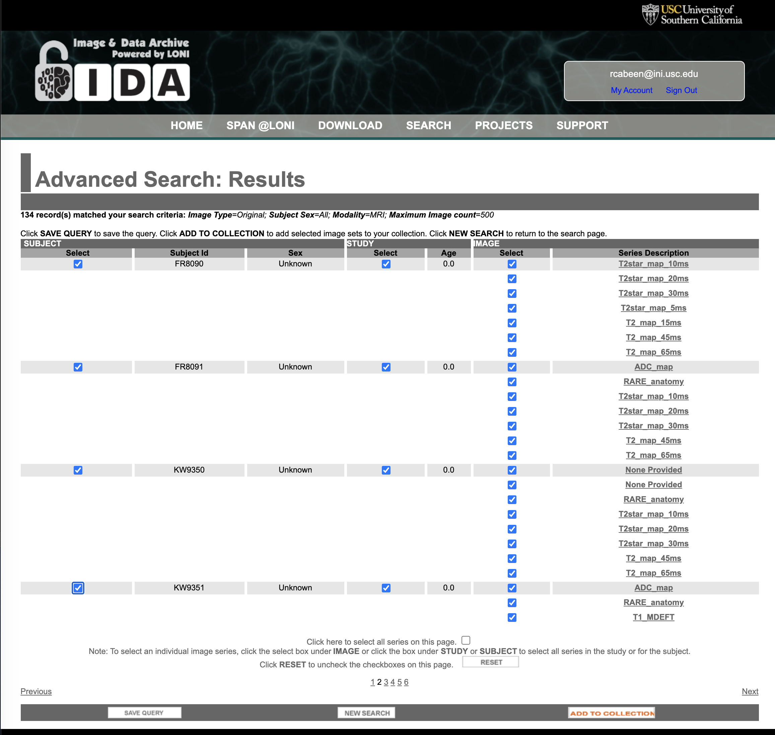
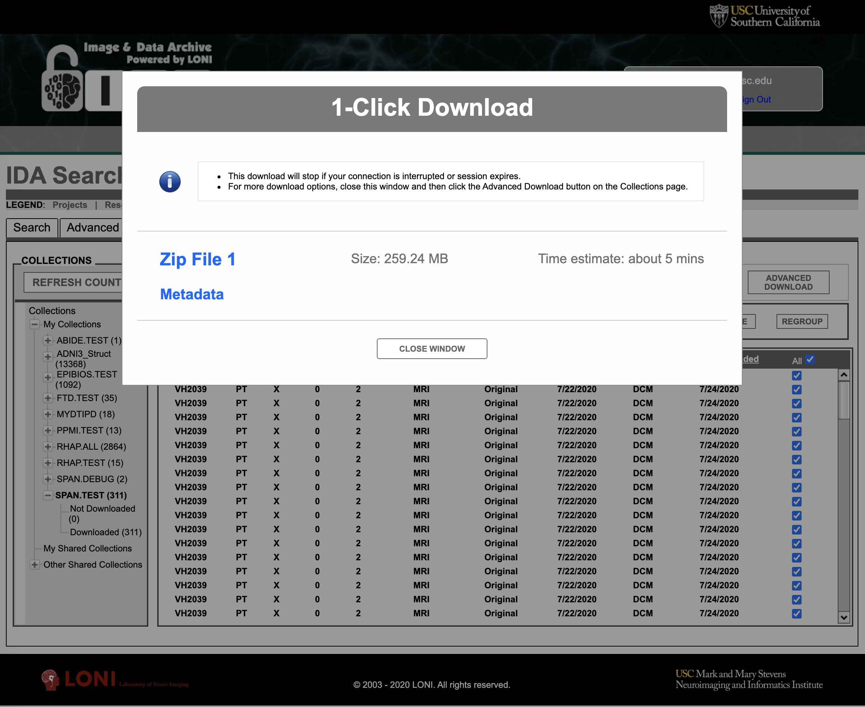
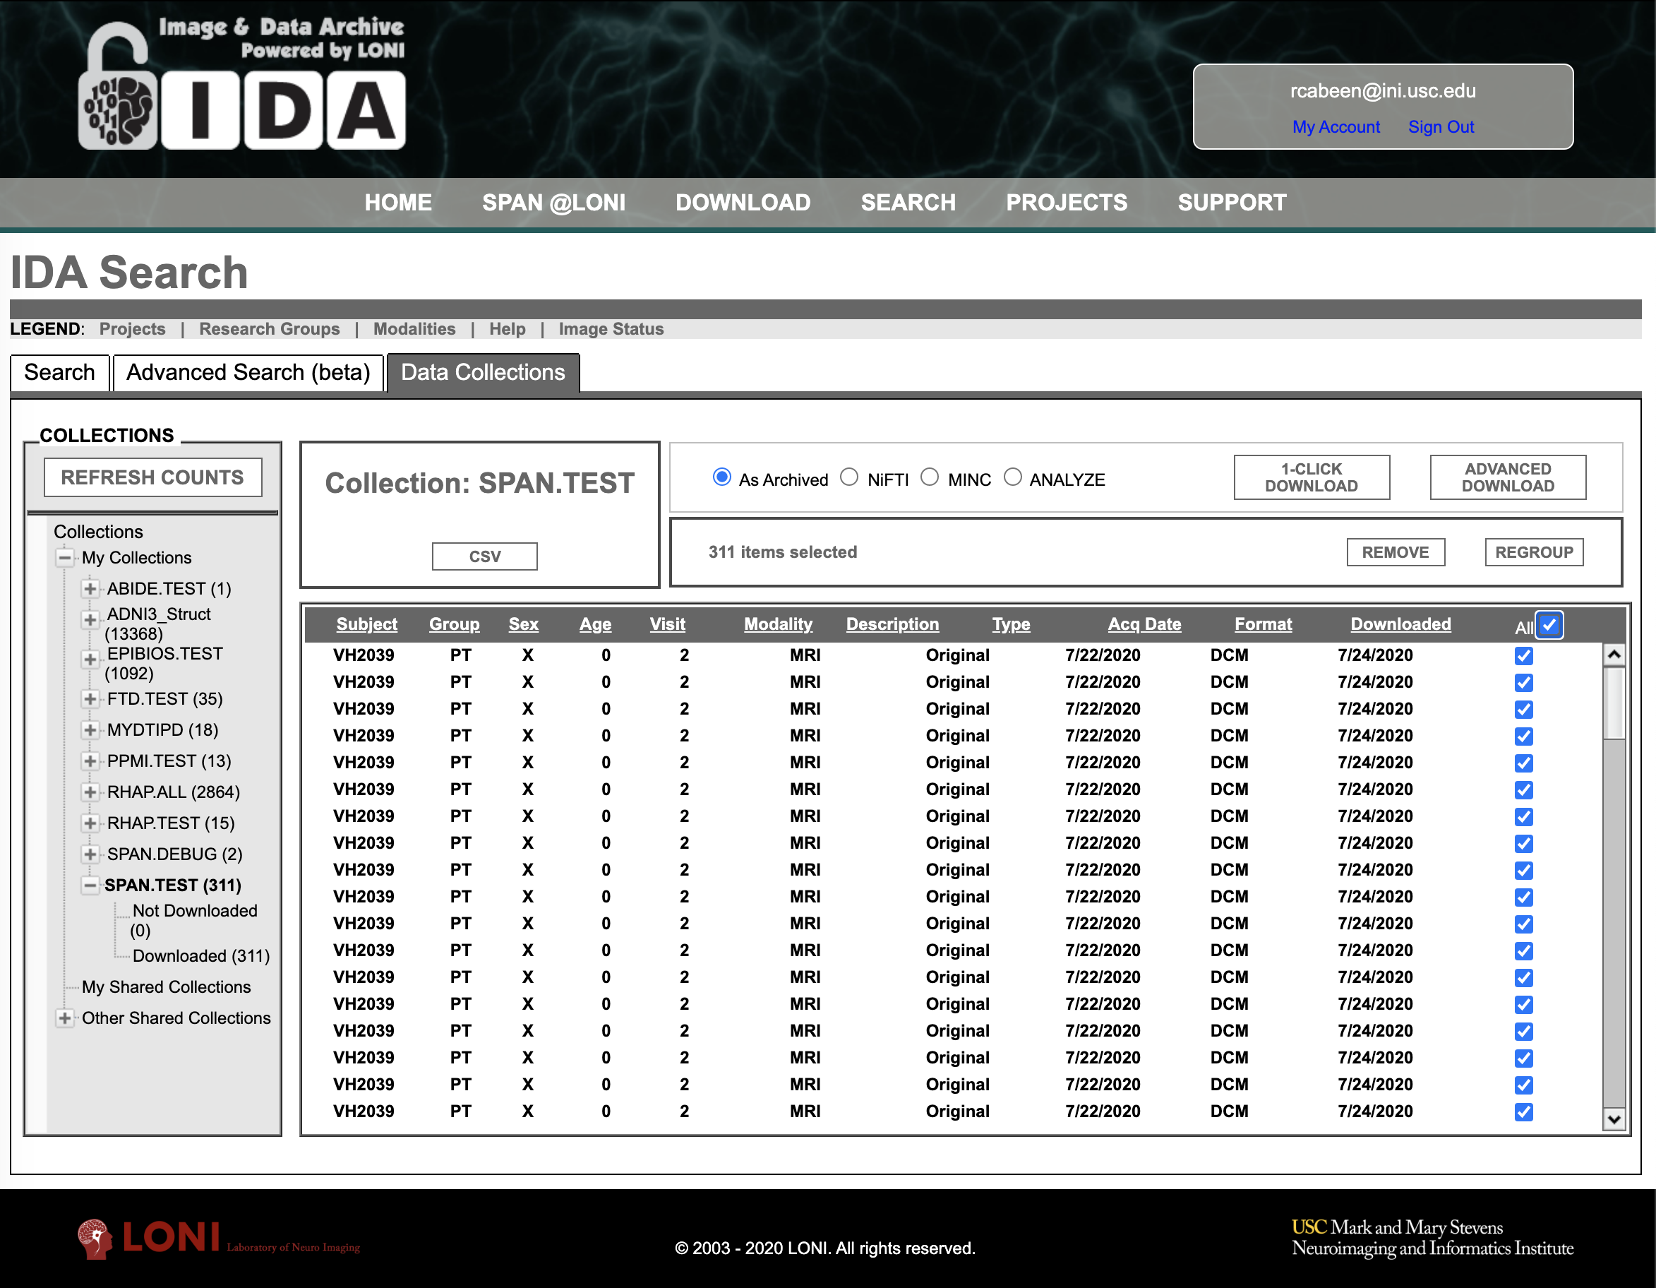
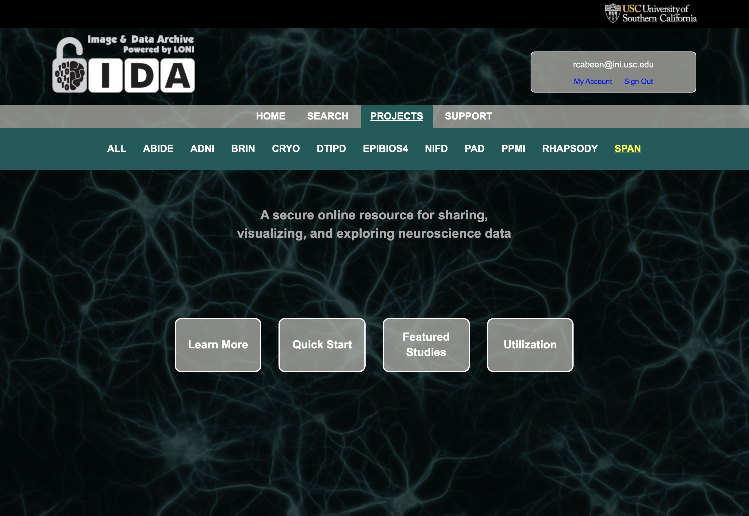
LONI IDA Data Wrangling Process
Download
Query
Login
Next steps…
Collect

Slide 4
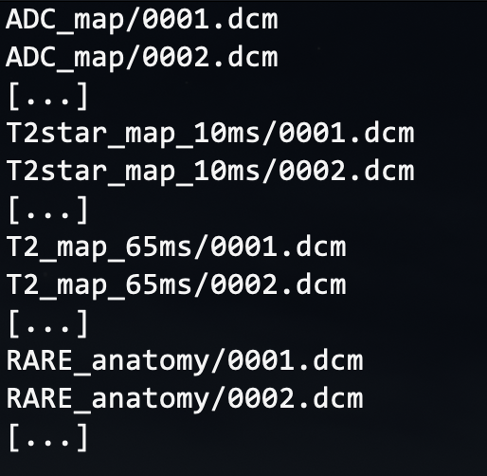
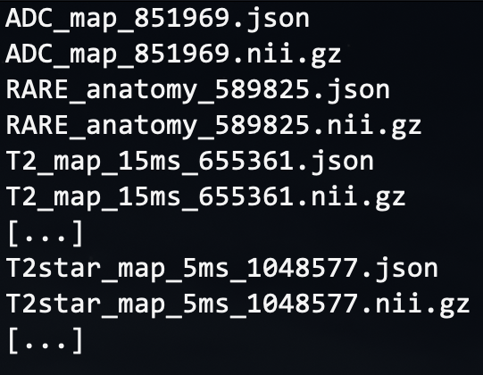
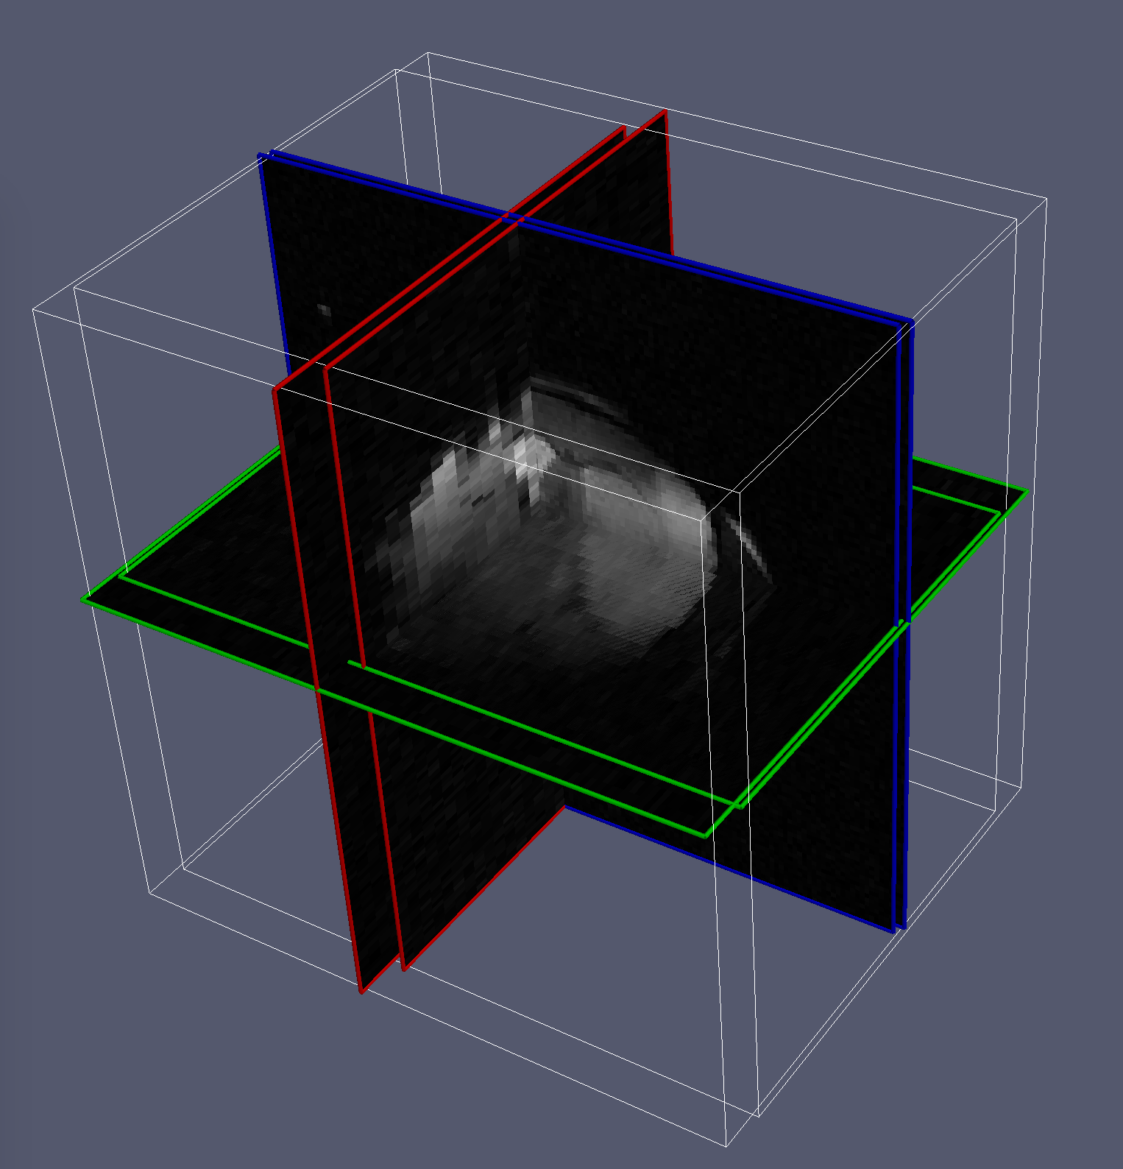
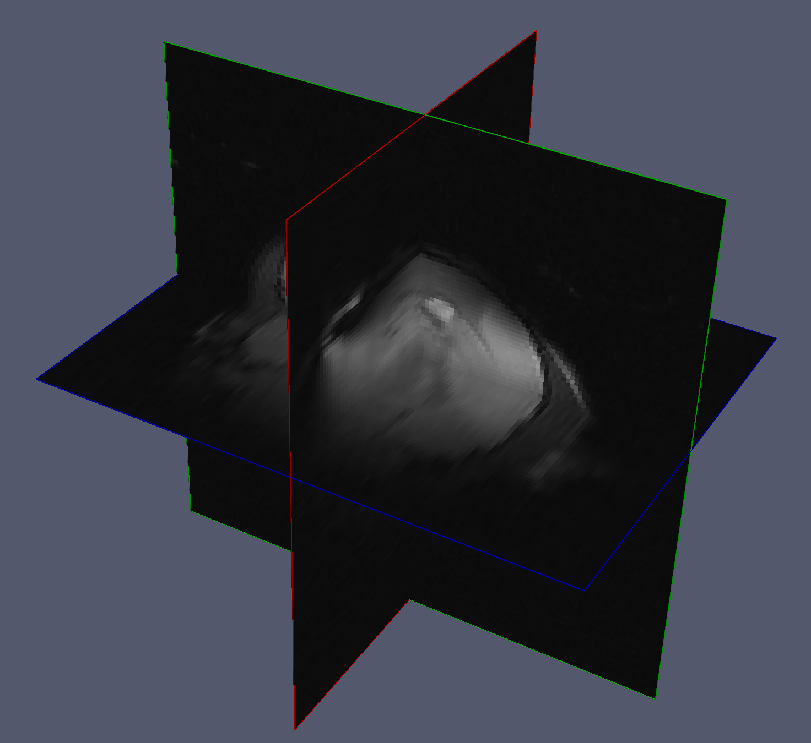
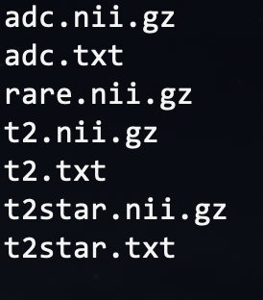
Image Preprocessing
File Format Conversion
DICOM to NIfTI
Extract
Meta-data (site & scan parameters)
Harmonize
3D Image orientation and resolution
Collect, Sort and Harmonize Scans
…
(note: DICOM names shortened for clarity)
(some sites use a different FOV within a single session)
(we harmonize the data to remove these differences)

Slide 5
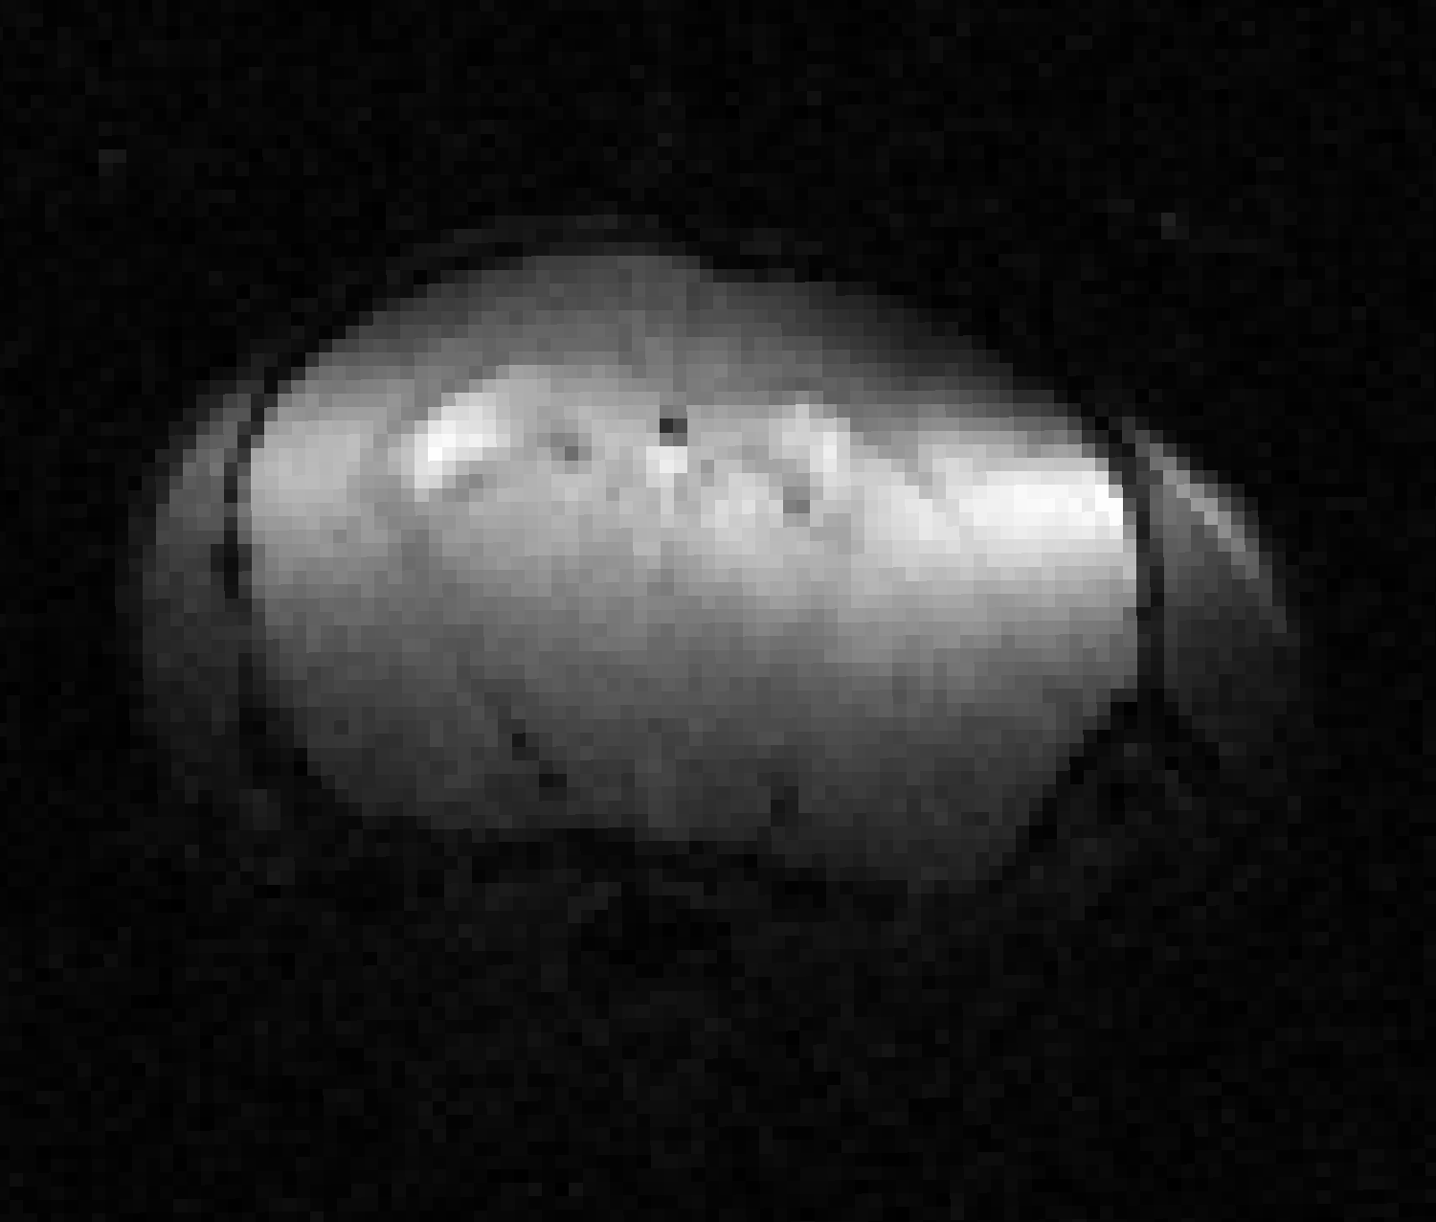
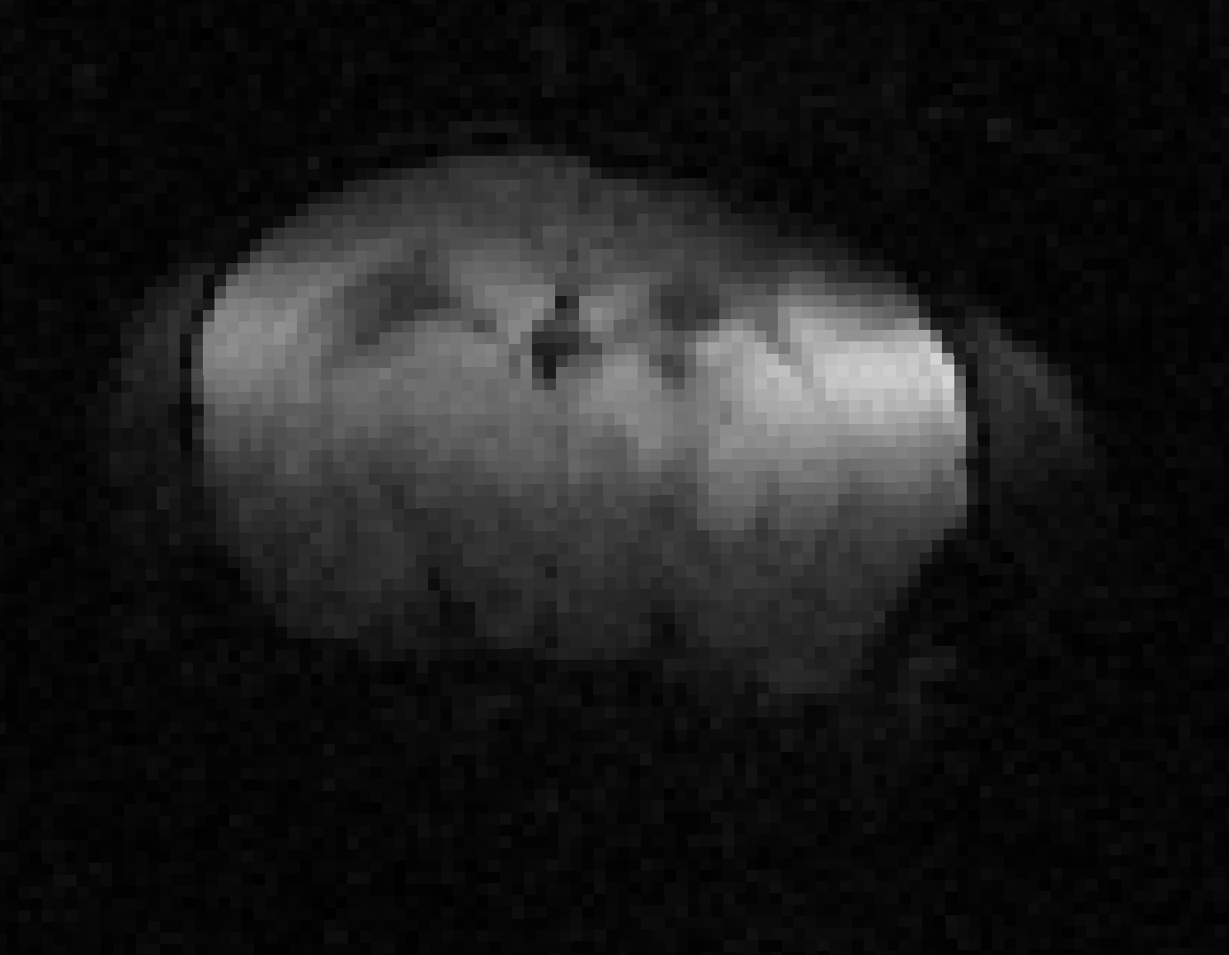
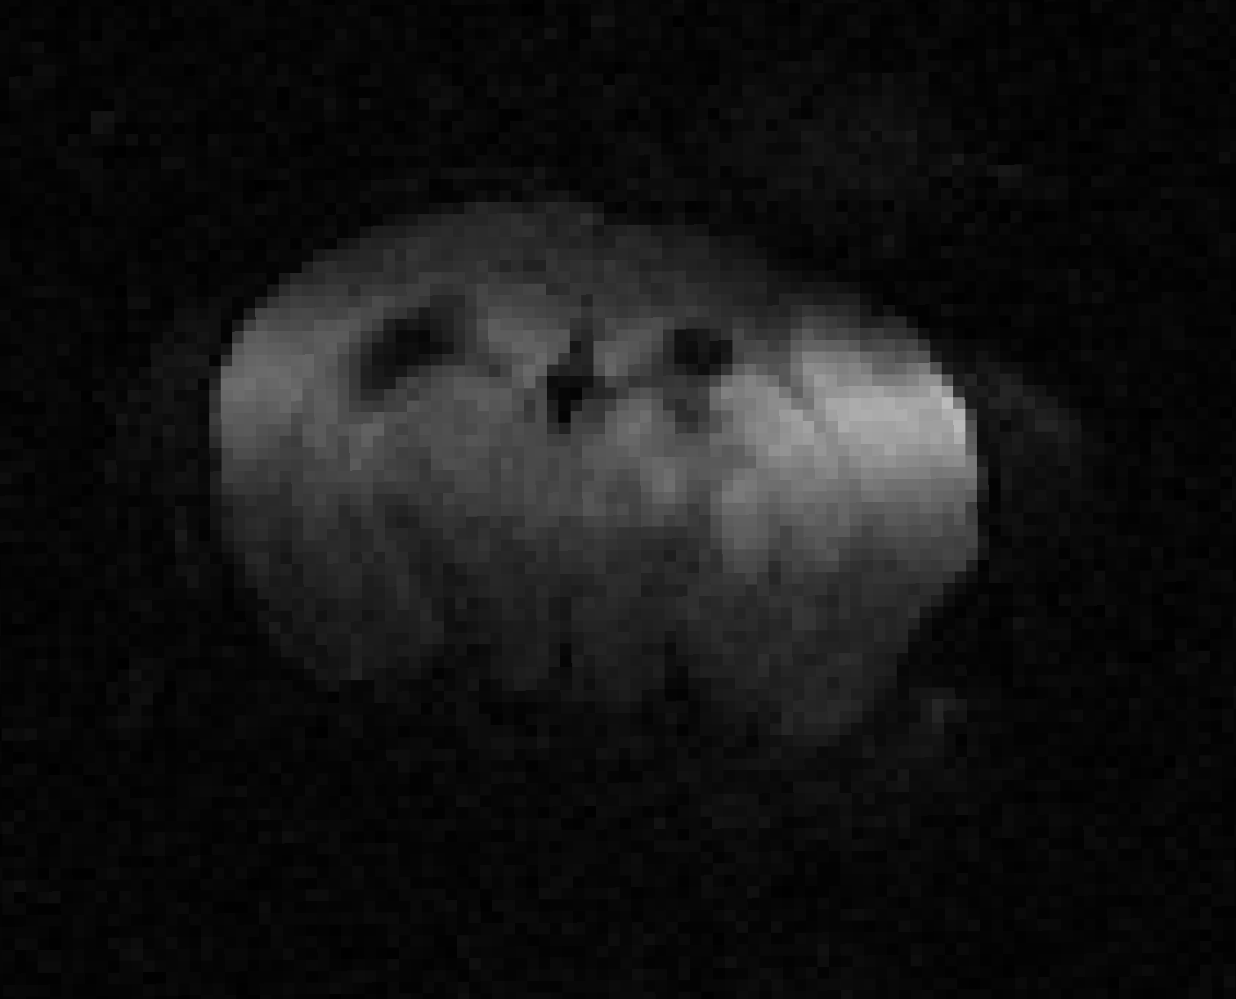
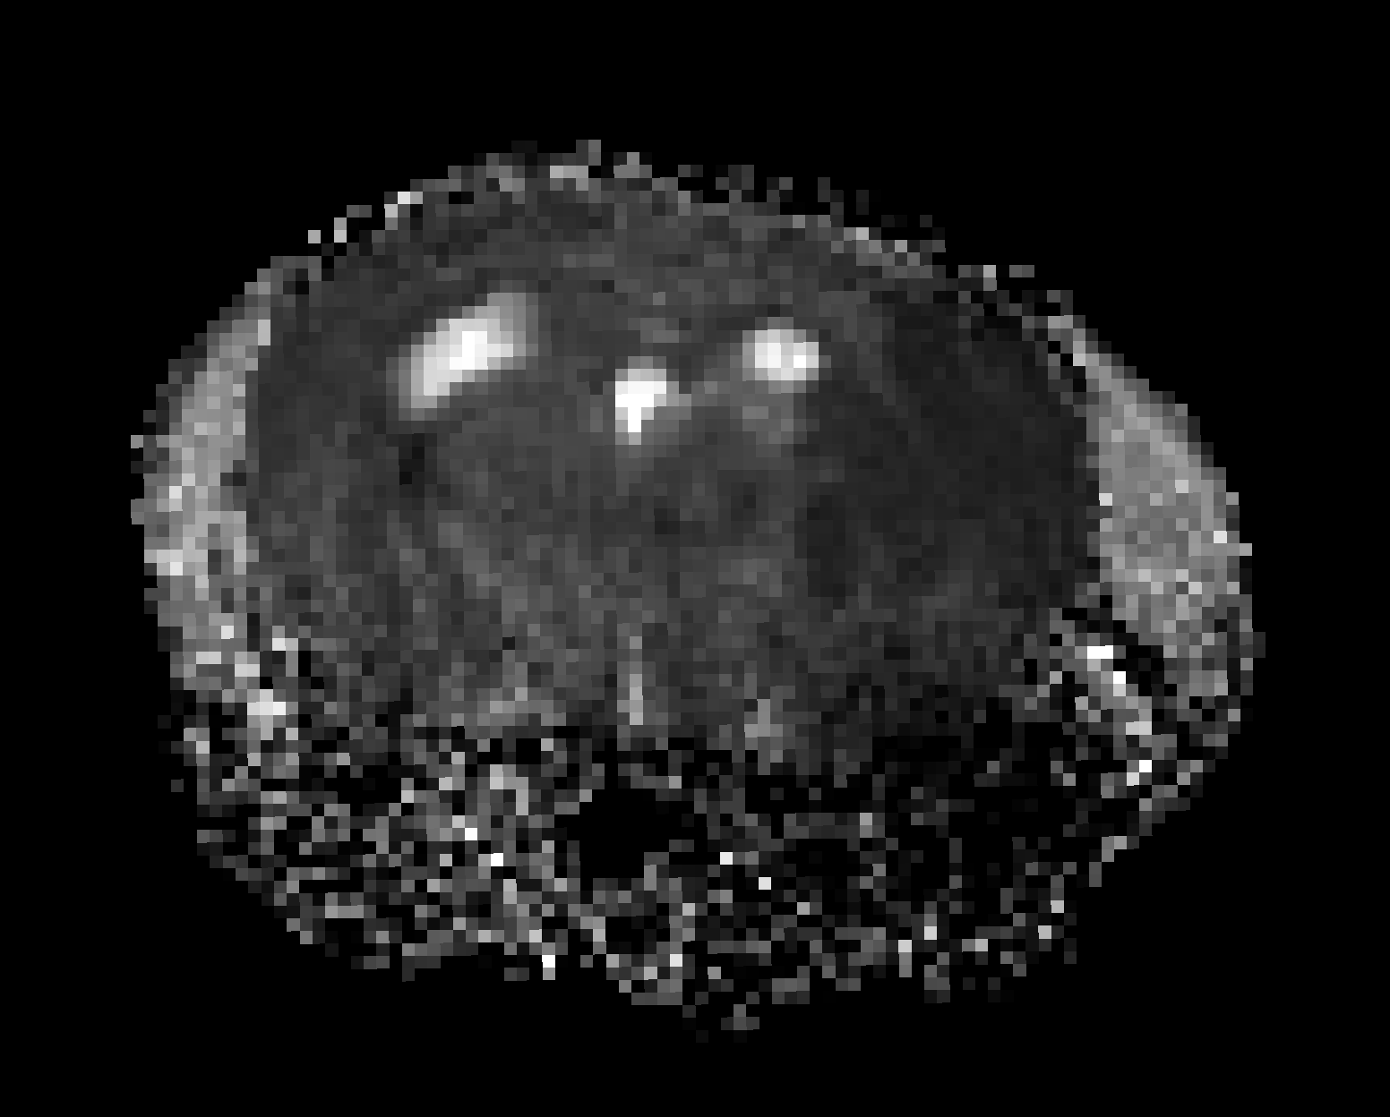
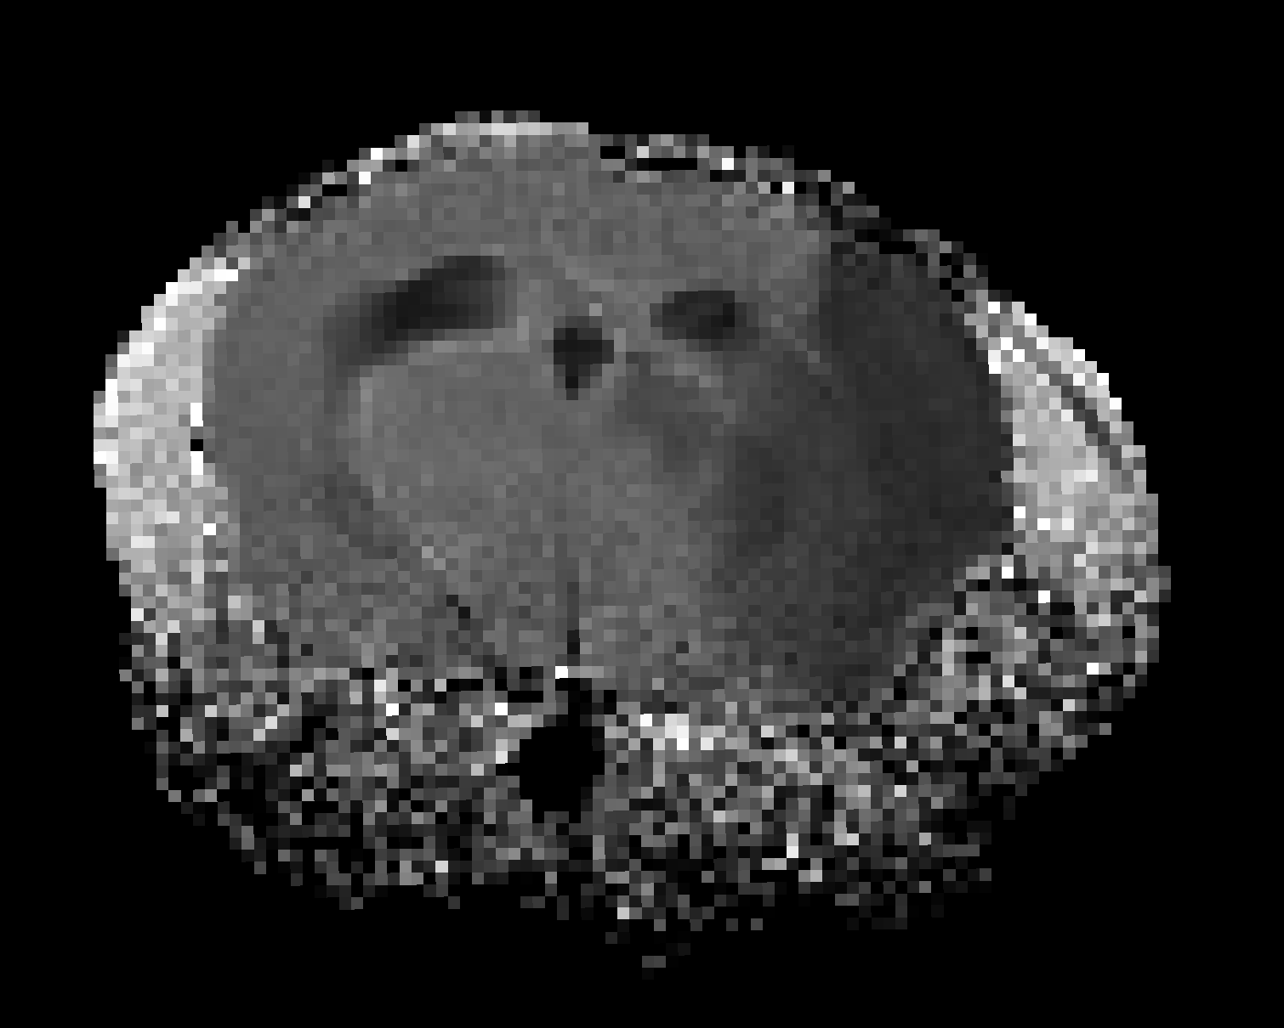
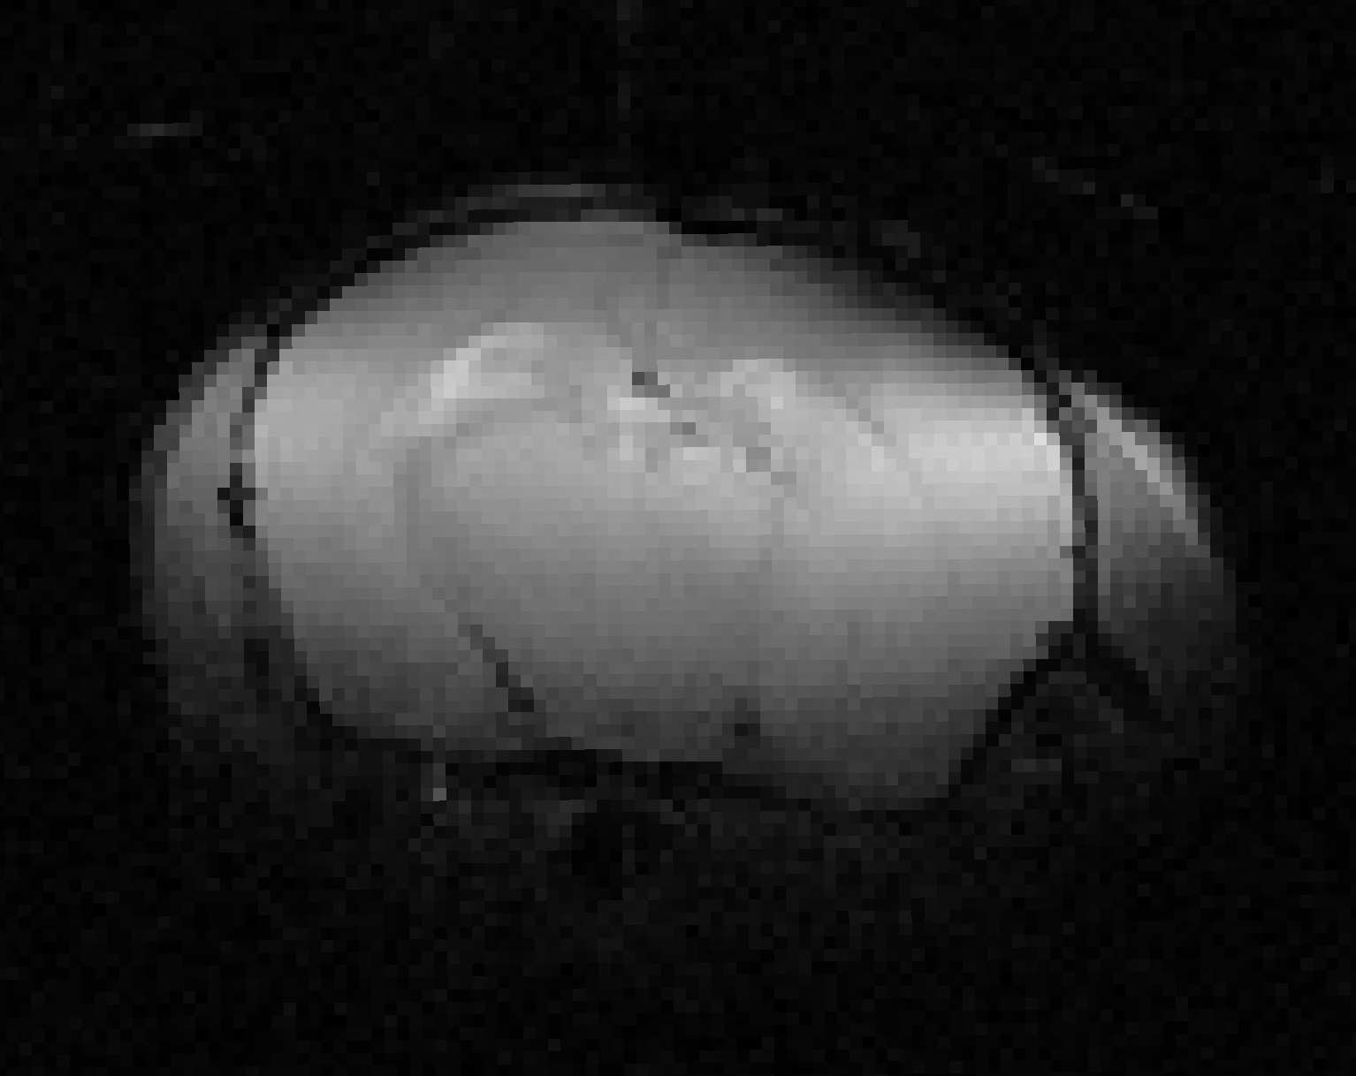
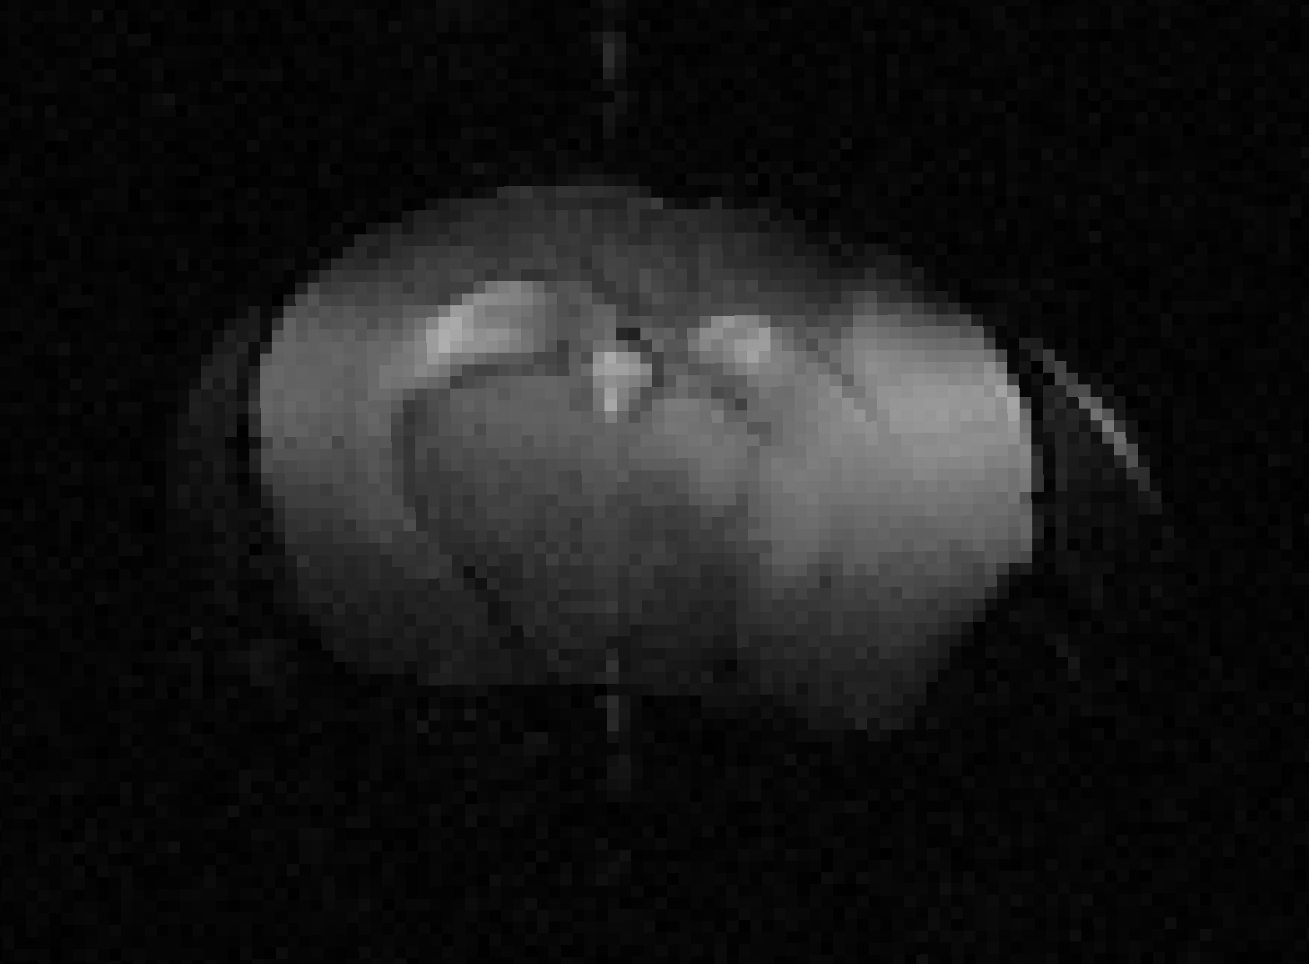
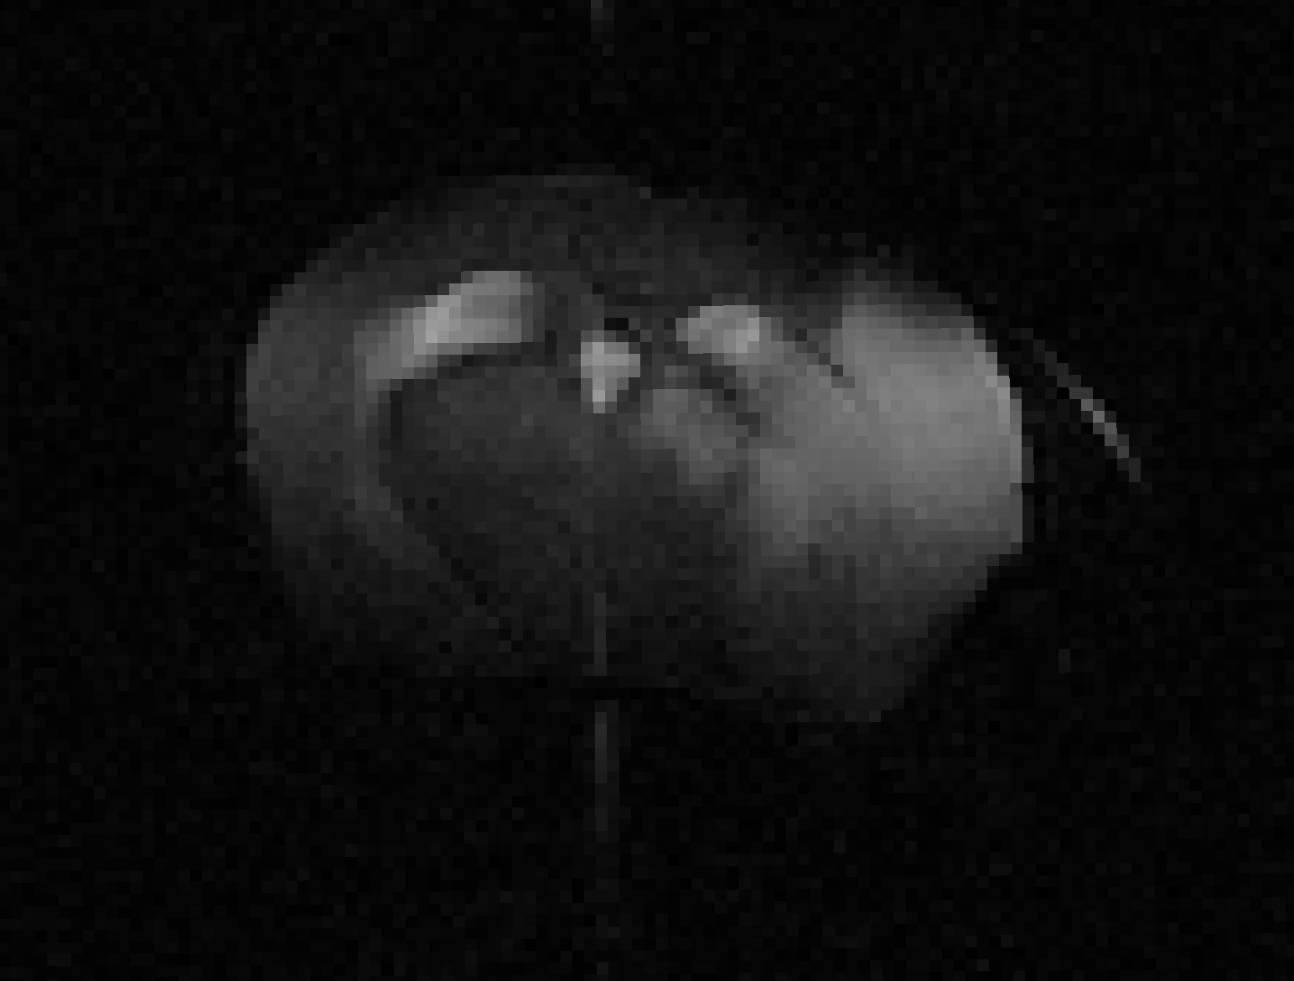
Parameter Estimation
Estimating the Apparent Diffusivity Coefficient (ADC) from multiple b-values
Fitting
b=0 s/mm²
b=500 s/mm²
b=1000 s/mm²
ADC
Estimating the T2 Relaxation Rate from multiple echo times
Fitting
TE=15ms
TE=45ms
TE=60ms
…
T2

Slide 6
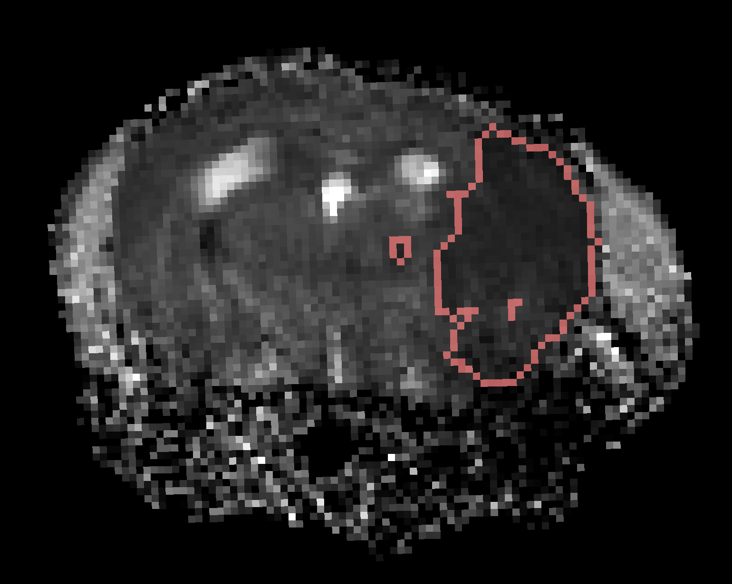
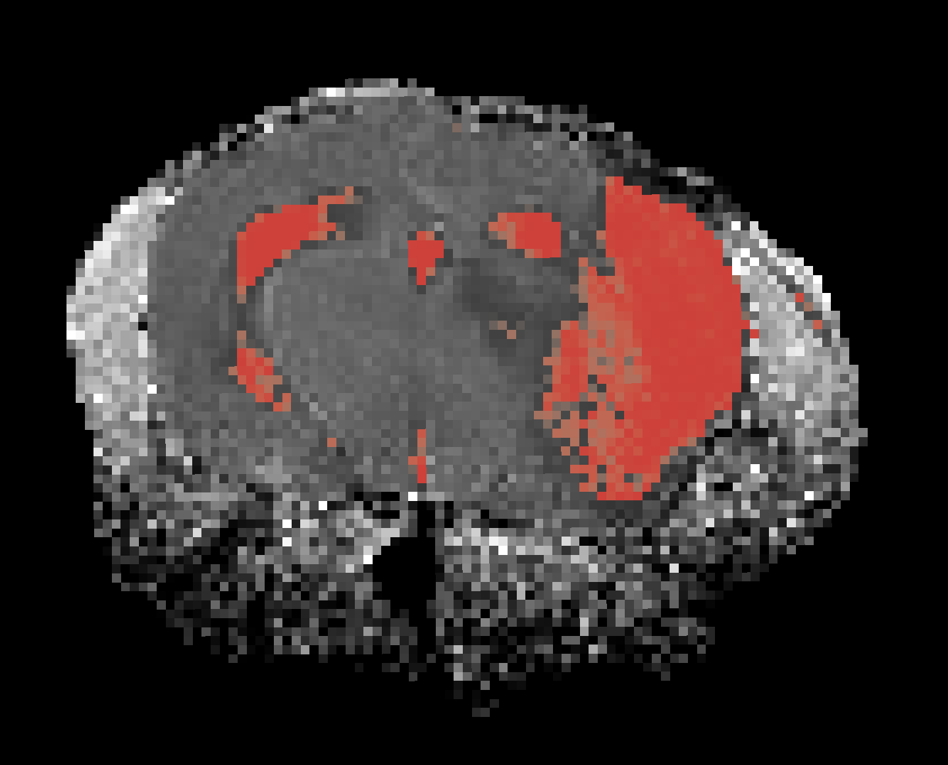
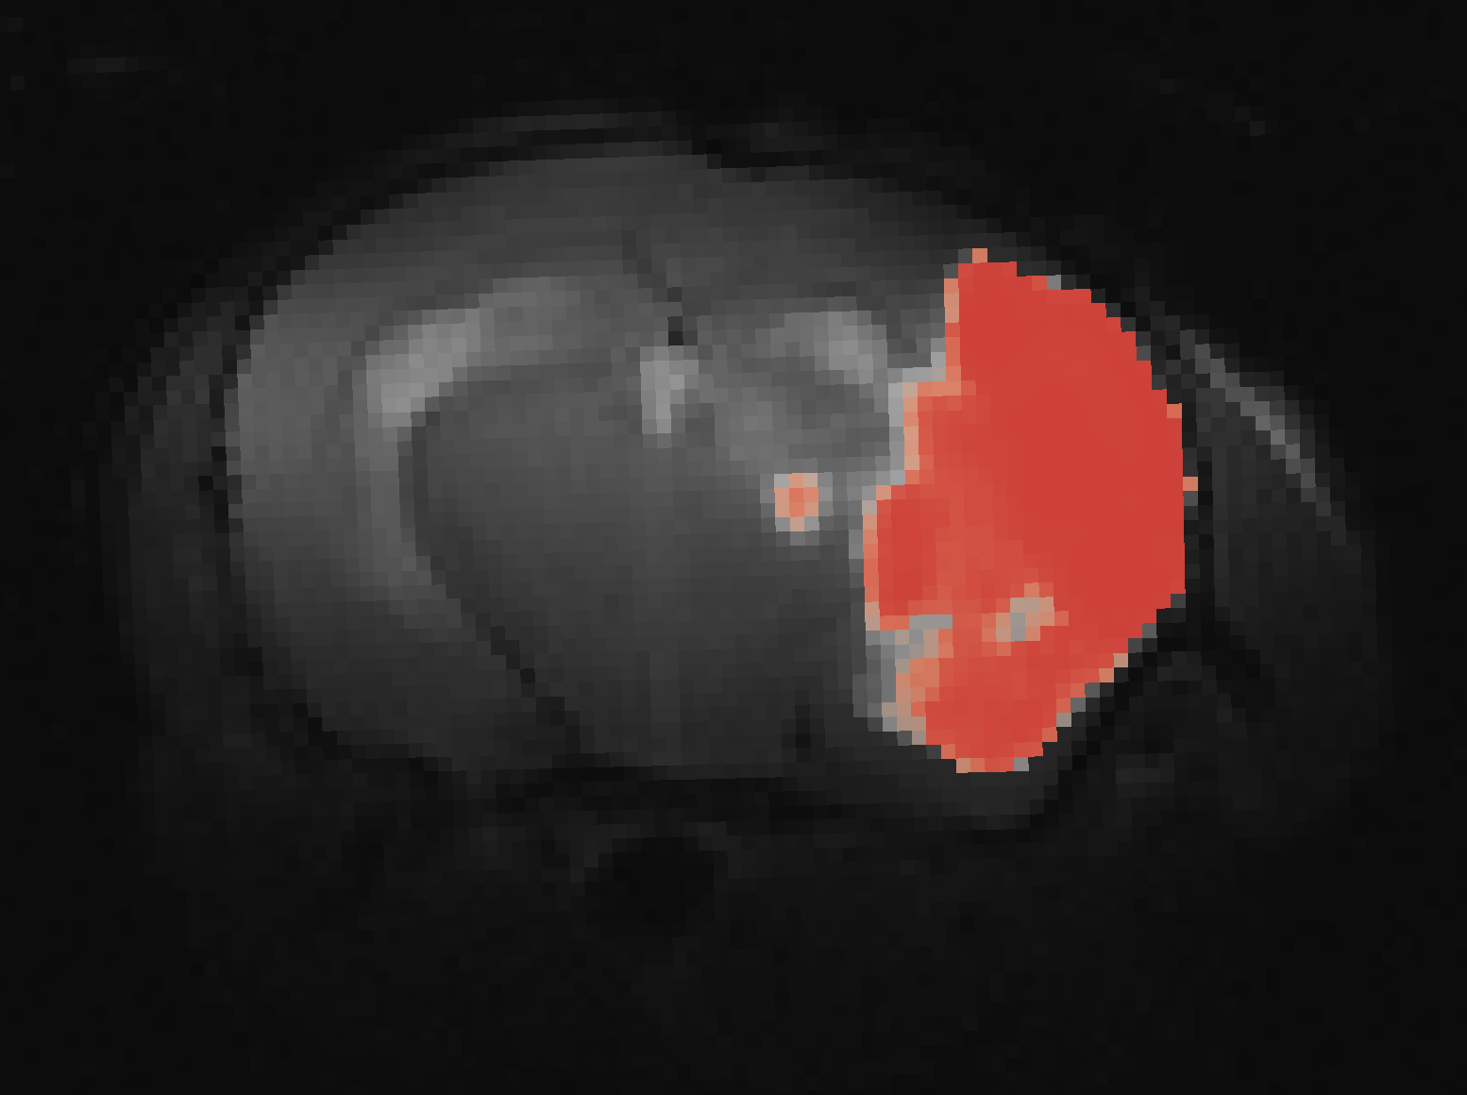
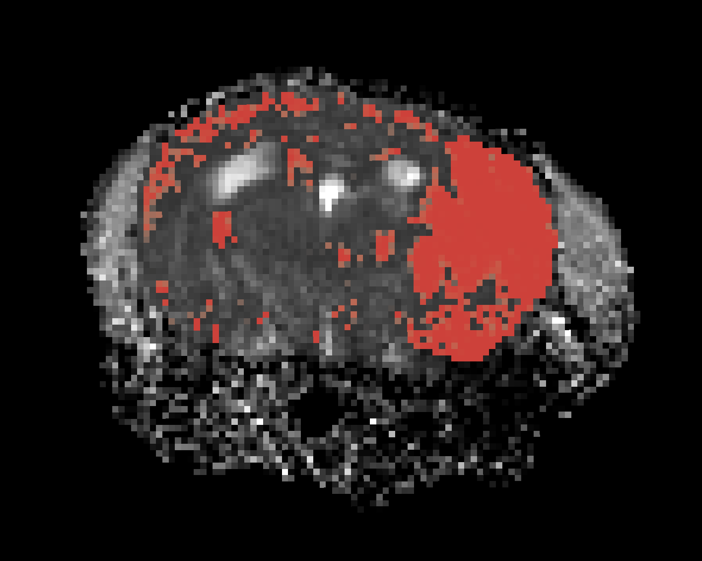
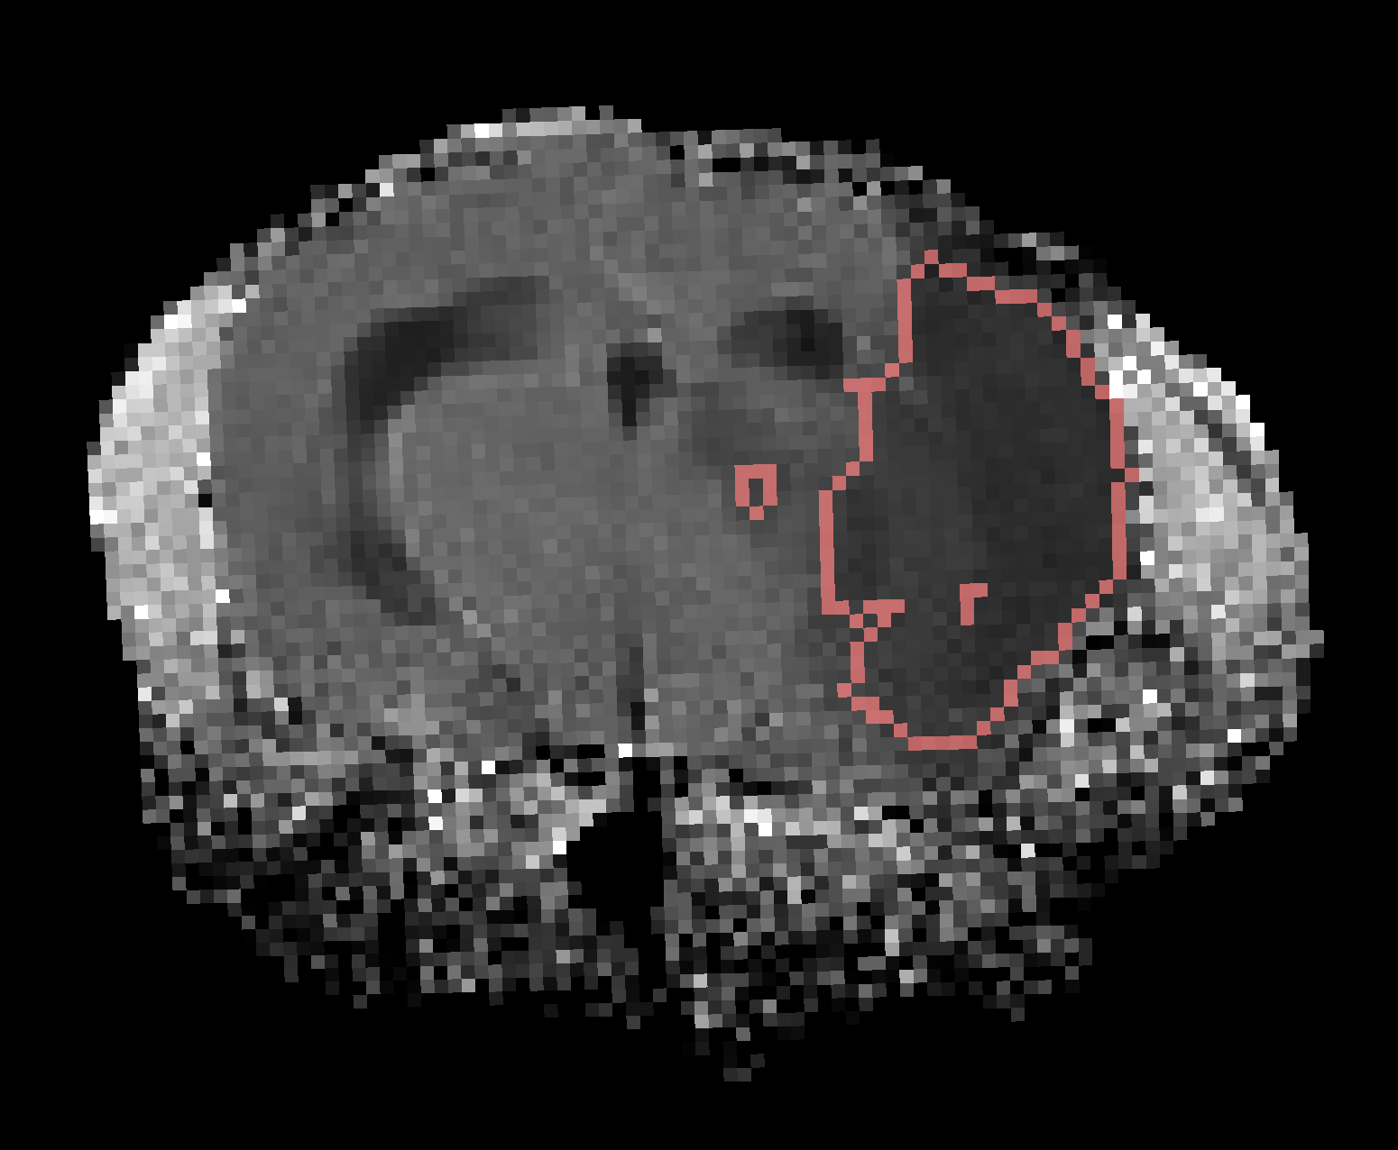
Lesion Segmentation
ADC
Intensity
Normalization
Probabilistic
Thresholding
Region
Extraction
T2
Combining Information from Multiple Contrasts

Slide 7
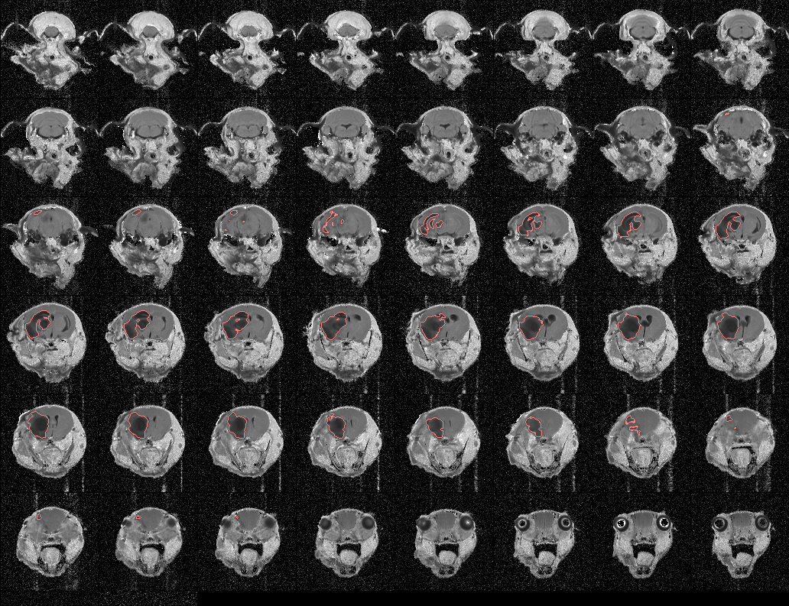
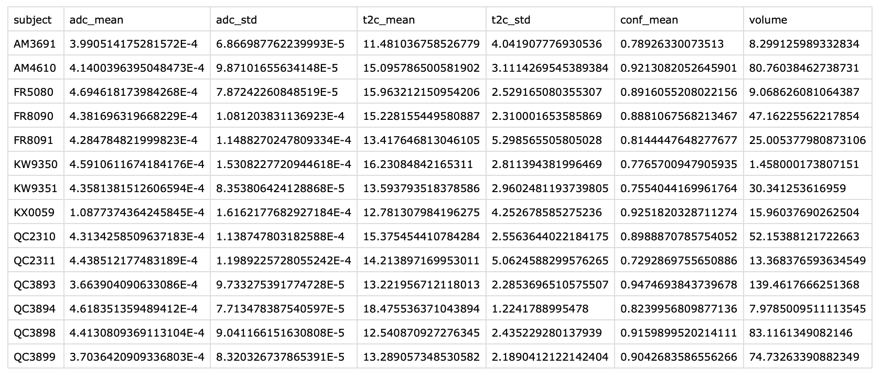
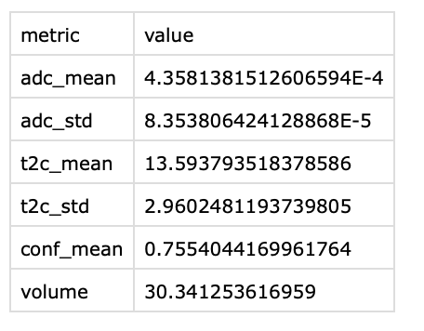
Analytics and Report Generation
Mosaic Plots
T2
ADC
Single Scan
Report of Imaging Metrics for Entire Cohort
Imaging Metrics for an Individual
Aggregate data with other all individuals

Slide 8
Progress Update – Data in the LONI IDA
Sites:
Hopkins
12 scans uploaded in total
9 similar scans with 3-bvalue ADC, 6-echo T2star, 10-echo T2, 1 RARE
3 scans with only localizers (not usable), 1 with oddball naming (QC3881)
Yale
8 scans uploaded in total
All had ADC
1 repeated ADC map, 1 with oddball naming (FR8090)
Variable number of T2 and T2star echoes (likely issue with metadata)

Slide 9
Progress Update – Data in the LONI IDA
Sites:
U. of Iowa
1 scan uploaded
3-echo T2, 4-echo T2star, 3-bvalue ADC, 1 RARE
GE scanner unlike other sites
UT
1 scan uploaded
10 echo T2, 4-echo T2star, 3-bvalue ADC, 1 RARE
Totals
22 scans with 17 conforming, 2 oddballs (usable), 3 localizers (unusable)

Slide 10
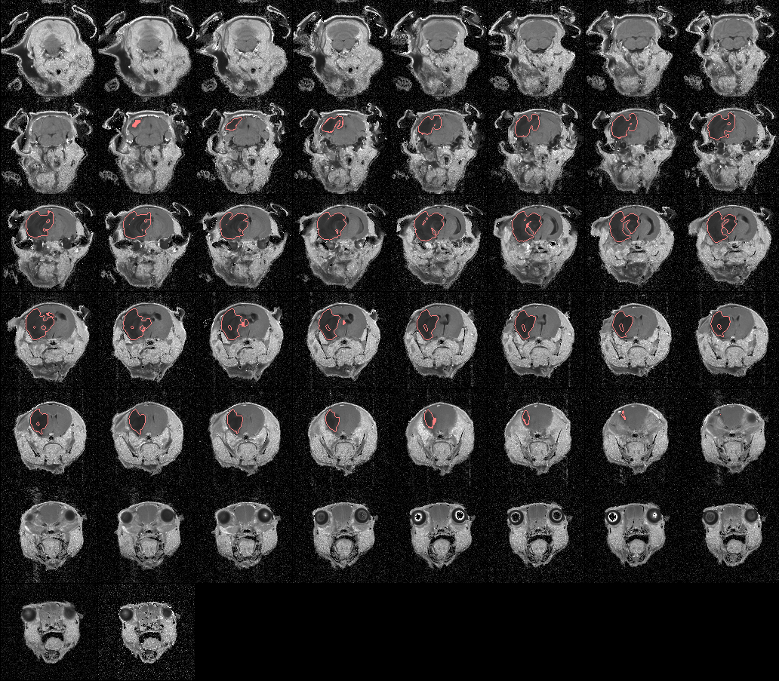
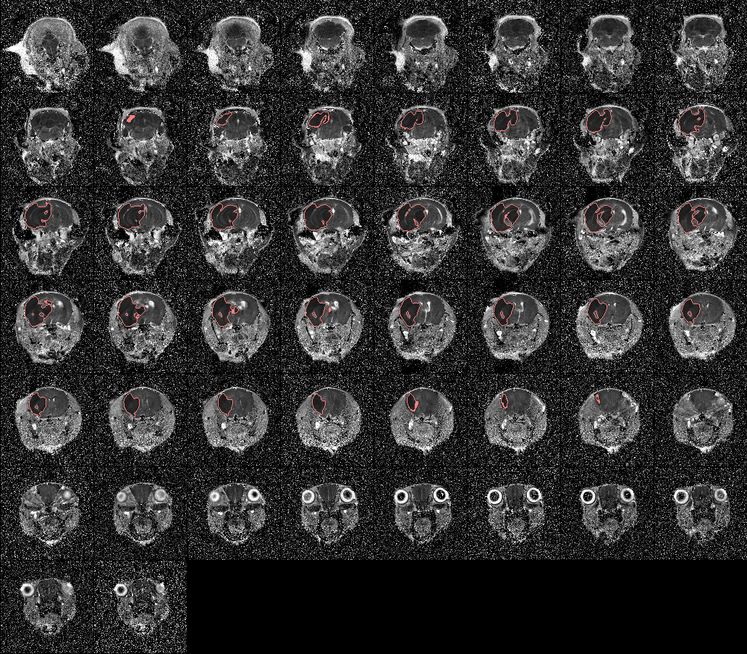
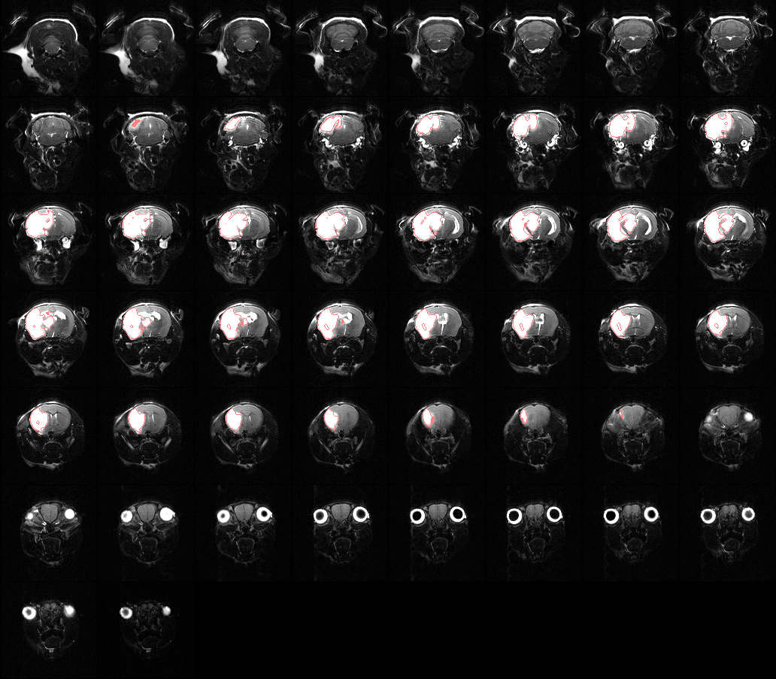
Some Results Hopkins QC3893
T2
ADC
RARE

Slide 11
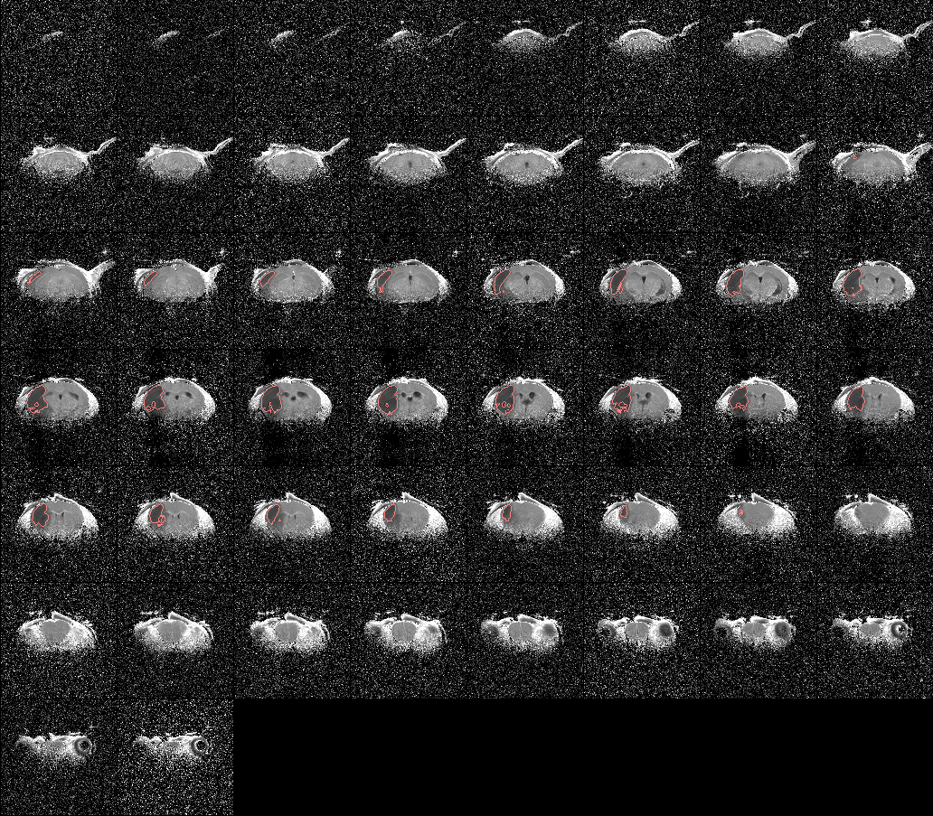
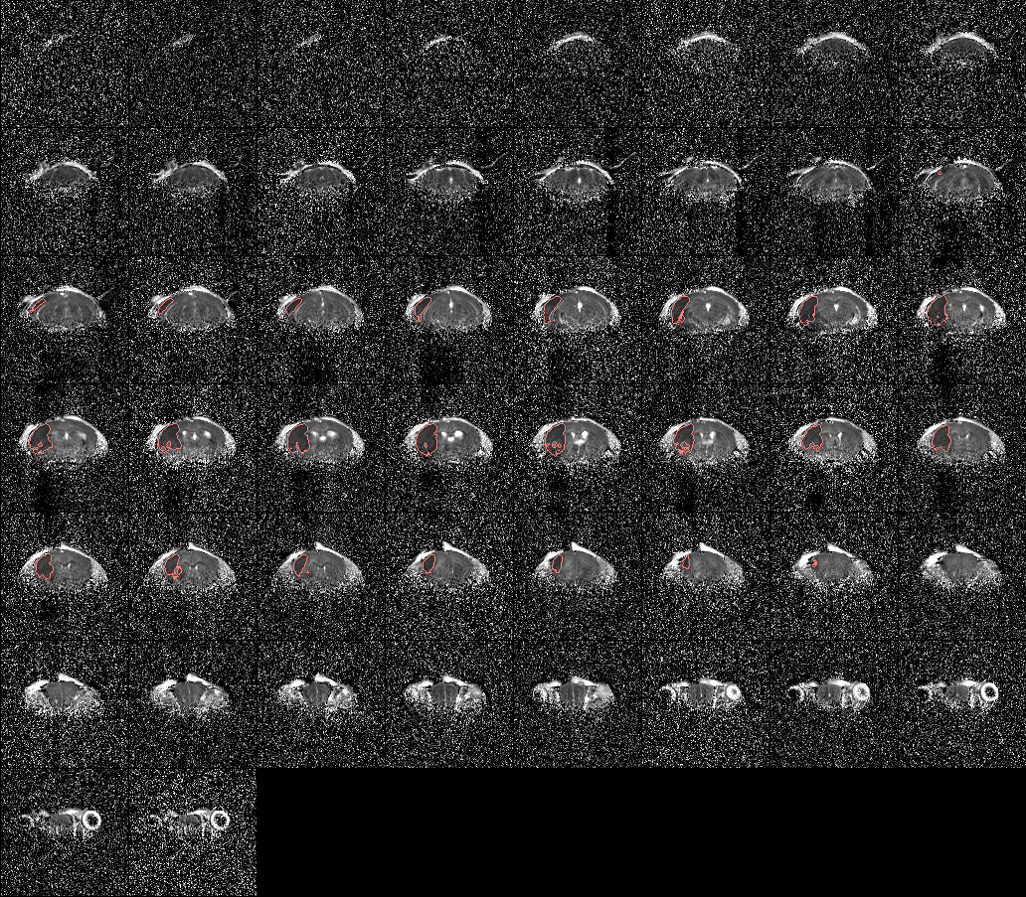
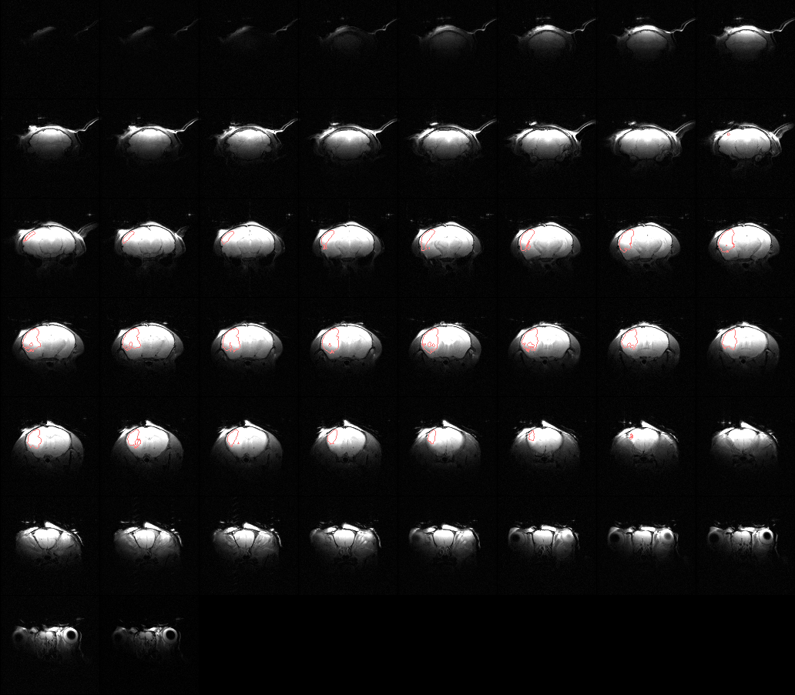
Some Results Yale FR8090
T2
ADC
RARE

Slide 12
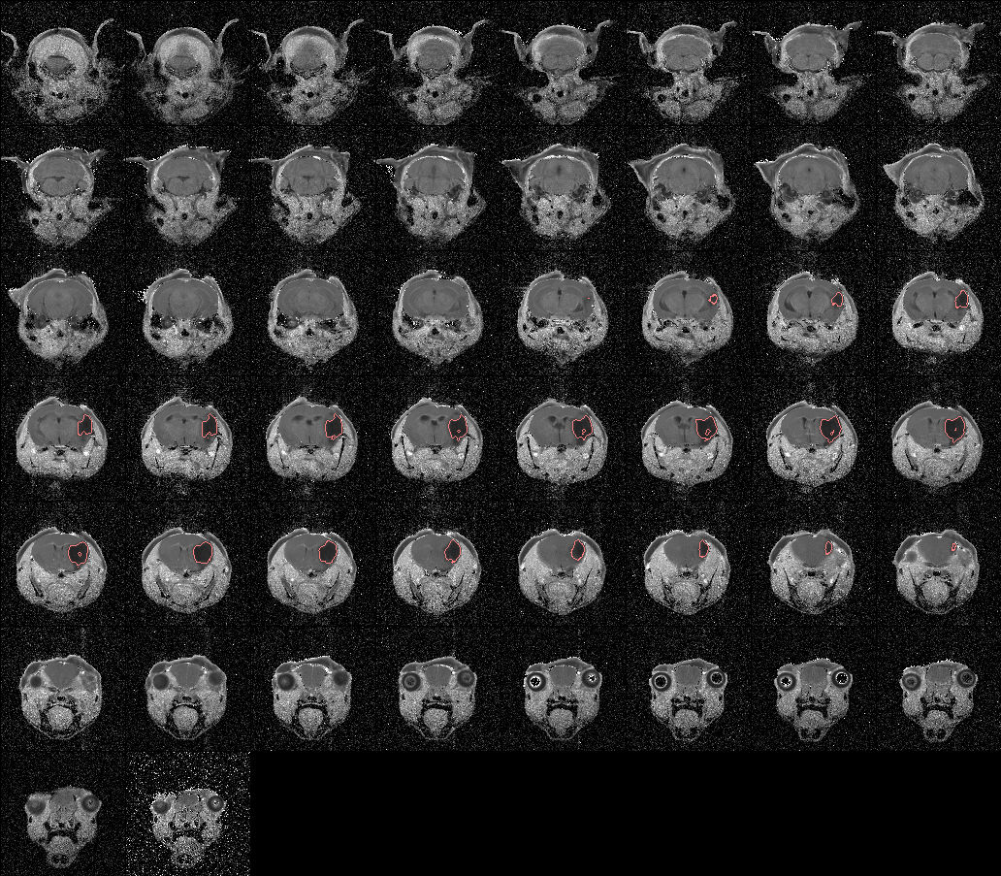
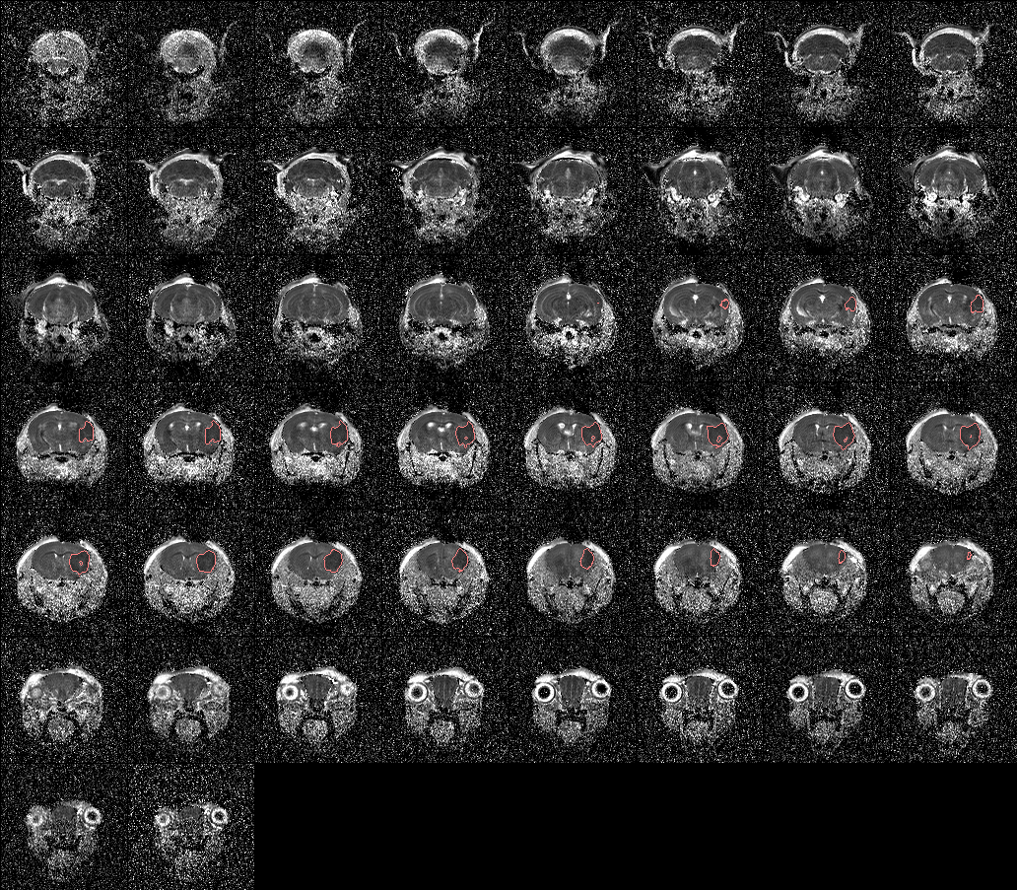
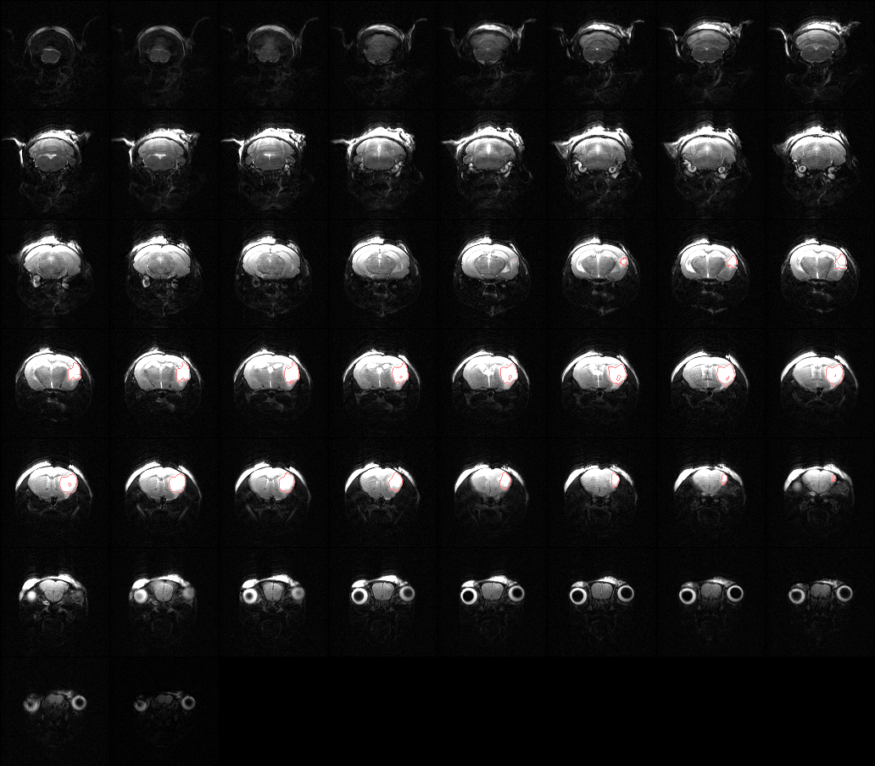
Some Results UT UT0002
T2
ADC
RARE

Slide 13
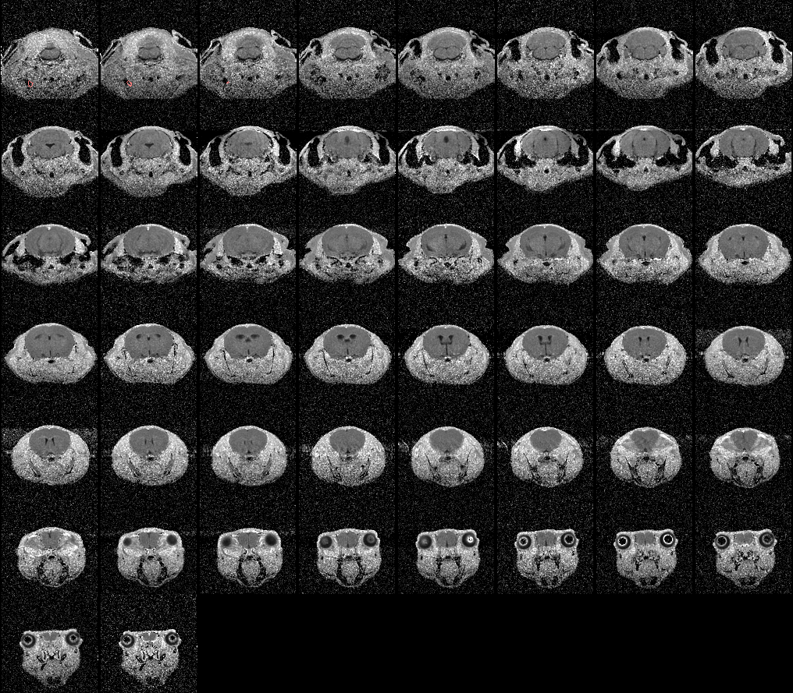
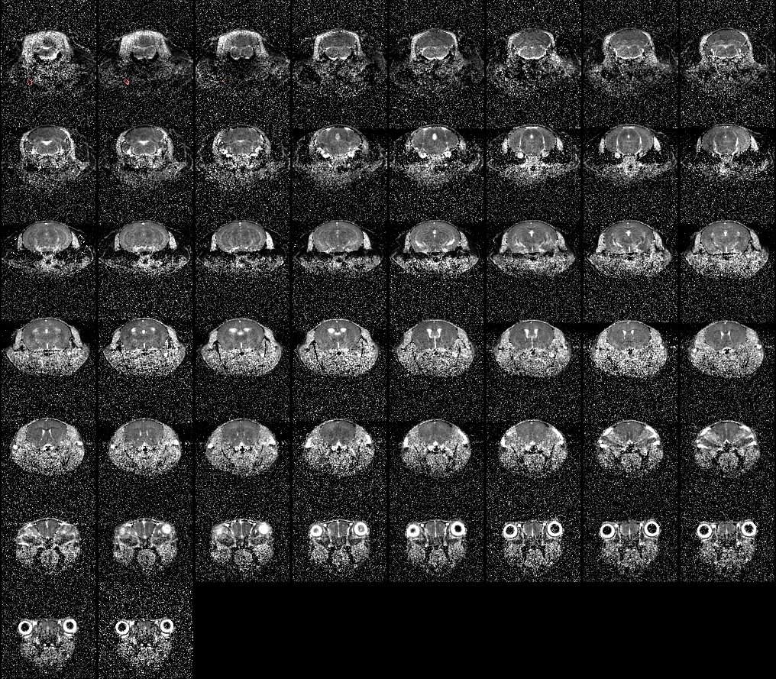
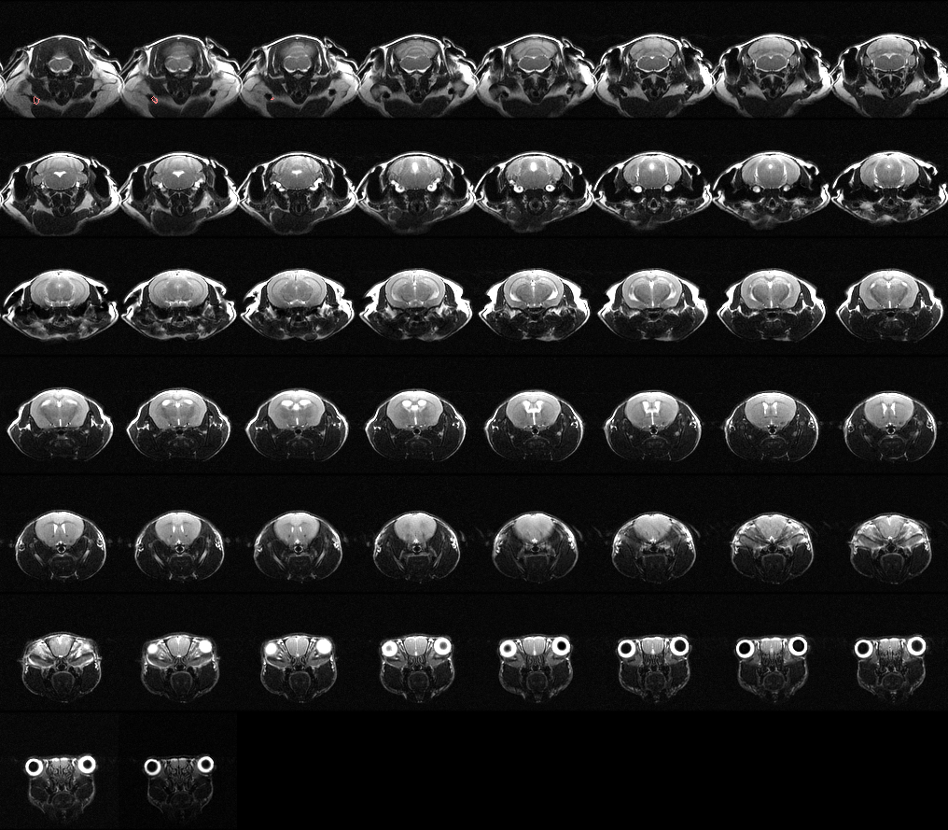
Some Results U of Iowa UI0000 (no lesion?)
T2
ADC
RARE

Slide 14
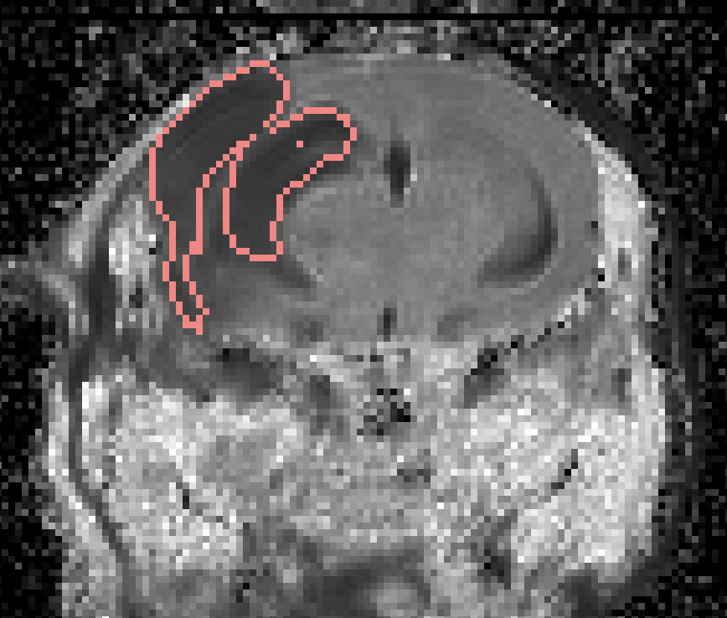
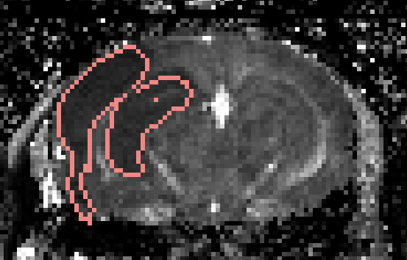
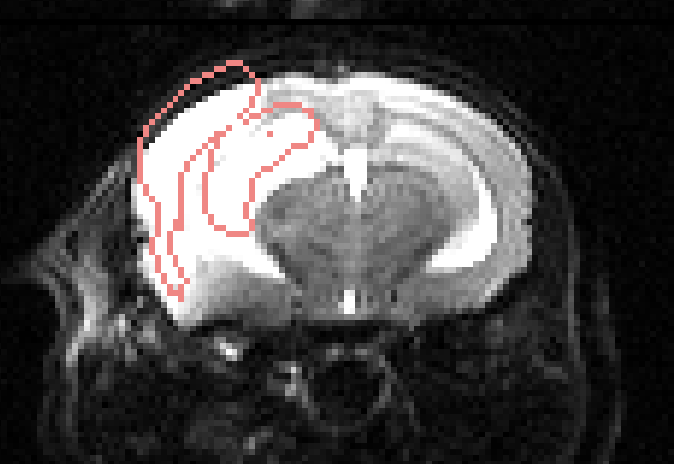
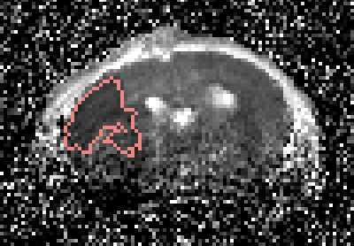
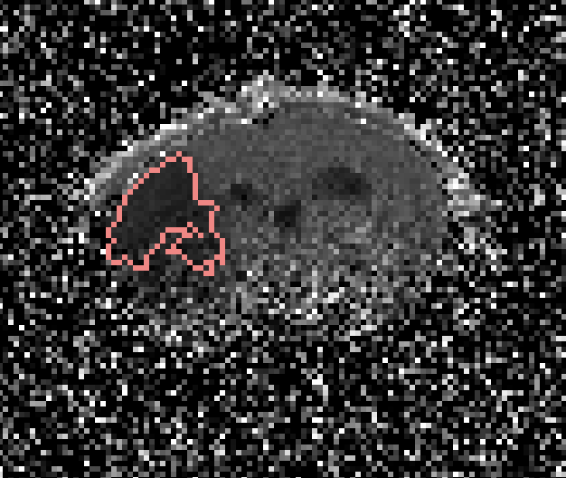
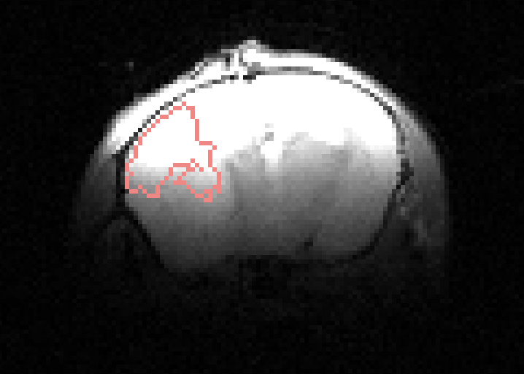
Concluding Observations
Motion Issue
T2
We can extract echo times from image headers
In-homogeneity of surface coils has an effect
Intra-session motion is a possibility (only one so far)
We have some upload issues being resolved (only for Yale)
Please send along scan descriptions for validation purposes, especially the number of echoes and hemisphere of the stroke
ADC
RARE
T2
ADC
RARE
In-homogeneity Issue

